Slide 1

Analysis of Algorithms
Order of Growth ,Asymptotic Notations & Examples
By Madhavi Alli

Slide 2
Asymptotic analysis
Complexity of an Algorithm: It is the amount of resources required for running algorithm.
Analysis of an Algorithm: Predicting or Estimating the amount of resources that the algorithm requires.
Asymptotic Analysis of Algorithm: Estimating amount of time required for large value of input size is called Asymptotic Analysis of Algorithm.
Asymptotic Notations: The notations used for describing the asymptotic running time of an Algorithm are called Asymptotic Notations.

Slide 3

Contd…..
What is the goal of analysis of algorithms?
  To compare algorithms mainly in terms of order of growth.
  What do we mean by running time analysis?
  Determine how running time increases as the input size increases.

Slide 4
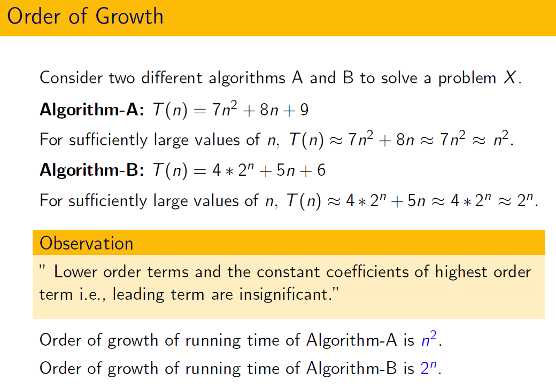
Order of Growth/ Rate of Growth
After dropping all lower order terms And constant of higher order term, whatever remains is “Order of Growth” or “Rate of Growth”.
In order to decide which algorithm is Efficient, we consider order of growth. Whichever algorithm has lower order of growth, that algorithm is efficient.
Order of Growth is always represented in terms of input size

Slide 5

Rate of Growth/ Order of Growth
It is the rate at which algorithm running time increases as input size increase i.e slower the running time grows as input size gets increase, the better is the algorithm. Asymptotic Notations captures this behavior.
Examples:
T(A)= 7n T(B)=7logn T(C)=n²
Compare rate of growth when input size increases from 100 to 10000
Algorithm B is better since it grows by just factor of2
Rate of Growth of an algorithm is inversely proportional to the efficiency of an Algorithm.
Algorithm is “efficient” when its runtime grows “slowly” with the input size.

Slide 6
Order of Growth…cont
To decide which algorithm is best, we should find out Rate of Growth, need not calculate total no.of steps and time for each step(All lower order terms and constant coefficient of higher order term are insignificant)
T(n)= 1000n³ + 999n + 9
= n³
The low order terms in a function are relatively insignificant for large n
n⁴ + 100n² + 10n + 50 ~ n⁴
i.e., we say that n⁴ + 100n² + 10n + 50 and n⁴ have the same rate of growth
Examples:
T(A)= n³
T(B) = 5000n²
For small value of n T(A) is smaller than T(B)
But at n=5000 T(A) overtakes T(B).
Compare n! and n^{n}

Slide 7
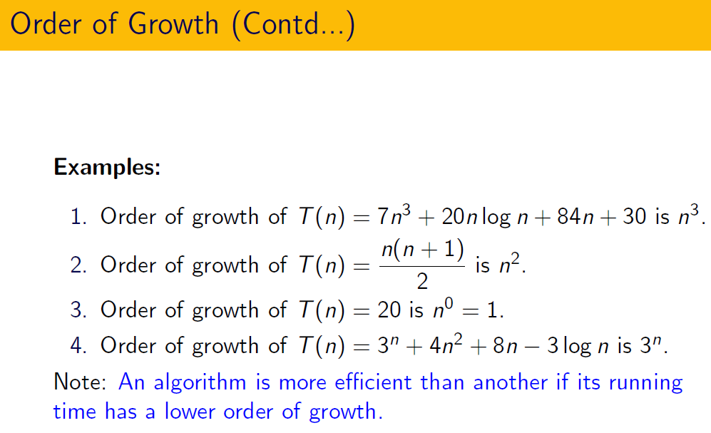

Slide 8
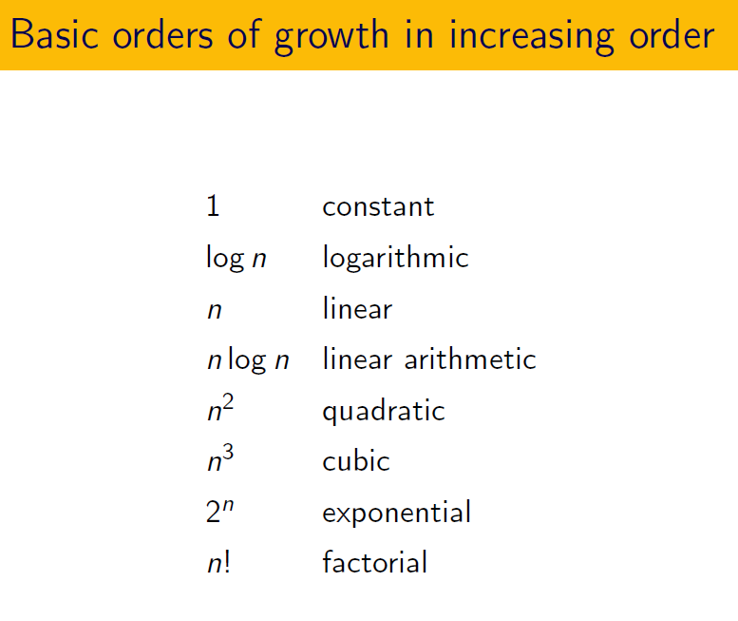

Slide 9
Asymptotic Notation
        The notations used for describing the asymptotic running time of an Algorithm are called Asymptotic Notations
        They are defined in terms of functions whose domains are the set of natural numbers

Slide 10
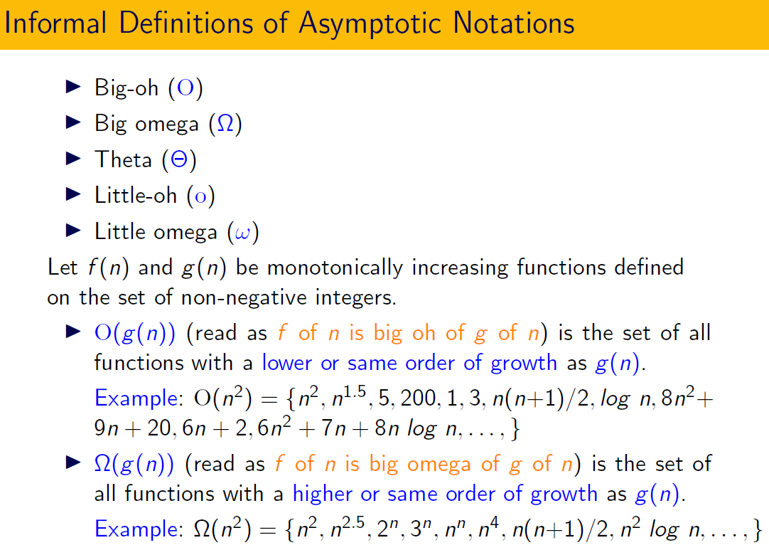
Informal definitions of Asymptotic Notations.

Slide 11
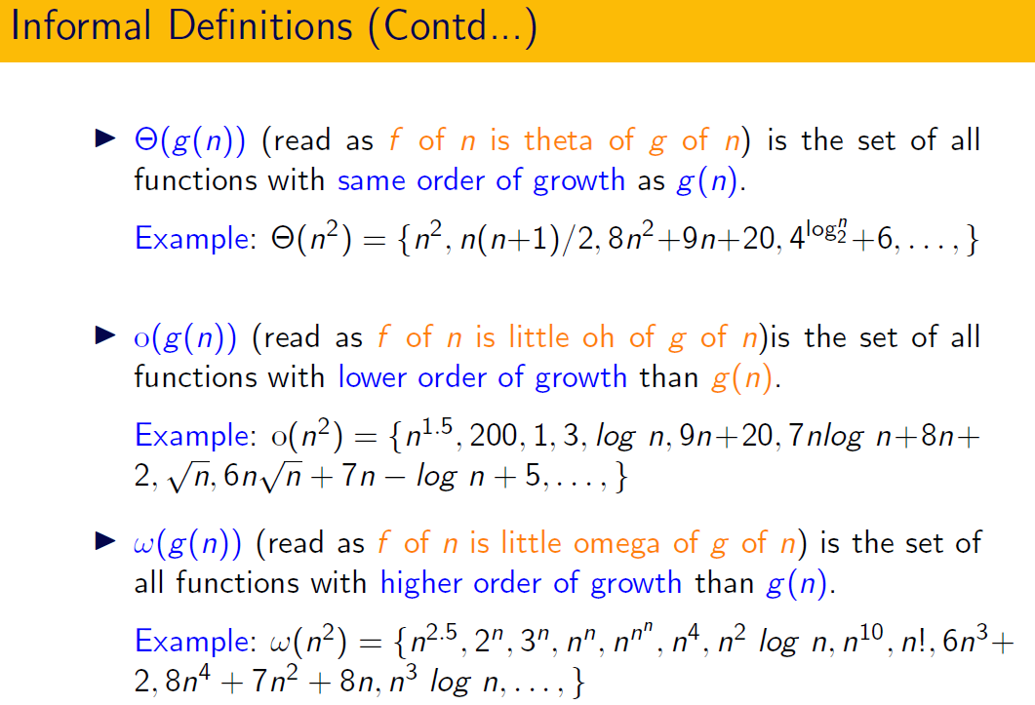
Informal definitions of Asymptotic Notations.

Slide 12
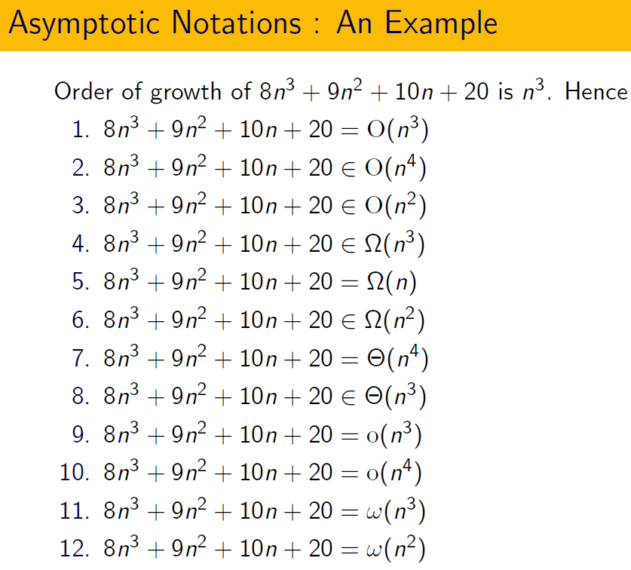
Example

Slide 13
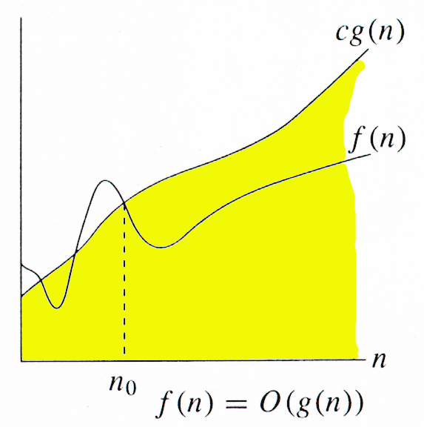
O-notation(Big-oh )
For function g(n), we define O(g(n)), big-O of n, as the set:
O(g(n)) = {f(n) :
∃ positive constants c and n_{0,} such that ∀n ≥ n₀,
we have 0 ≤ f(n) ≤ cg(n) }
Intuitively: Set of all functions whose rate of growth is the same as or lower than that of g(n). g(n) grows as quickly as f(n)
g(n) is an asymptotic upper bound for f(n).
f(n) = O(g(n)).

Slide 14
O Notaion…cont
Order of growth of f(n) is either equal to or lower than that of order of growth of g(n).
This notation is useful to describe Worst case time complexity of an algorithm.
Describes the tight upper bound time complexity of an algorithm.
An absolute guarantee that the algorithm would not run longer, no matter what the inputs are

Slide 15
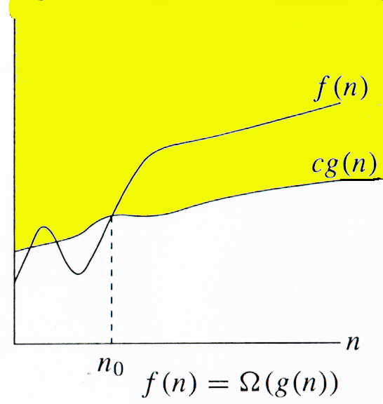
Ω -notation(Big Omega)
For function g(n), we define Ω(g(n)), big-Omega of n, as the set:
Ω(g(n)) = {f(n) :
∃ positive constants c and n_{0,} such that ∀n ≥ n₀,
we have 0 ≤ cg(n) ≤ f(n)}
Intuitively: Set of all functions whose rate of growth is the same as or higher than that of g(n). g(n) grows at least as slowly as f(n)
g(n) is an asymptotic lower bound for f(n).
f(n) = Ω(g(n)).

Slide 16
Ω Notaion…cont
Order of growth of f(n) is either equal to or greater than that of order of growth of g(n).
This notation is useful to describe Best case time complexity of an algorithm.
Describes the tight lower bound time complexity of an algorithm.
Input is the one for which the algorithm runs the fastest.

Slide 17
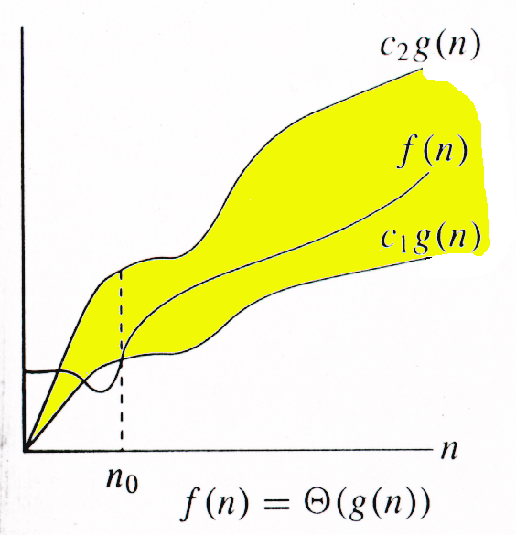
Θ-notation
For function g(n), we define Θ(g(n)), big-Theta of n, as the set:
Θ(g(n)) = {f(n) :
∃ positive constants c₁, c₂, and n_{0,} such that ∀n ≥ n₀,
we have 0 ≤ c₁g(n) ≤ f(n) ≤ c₂g(n)
}
Ω
Intuitively: Set of all functions that
have the same rate of growth as g(n).
g(n) & f(n) have same rate of growth
g(n) is an asymptotically tight bound for f(n).
f(n) = O(g(n)) as well as f(n) = Ω(g(n)).

Slide 18
Θ Notaion…cont
Order of growth of f(n) is same as order of growth of g(n).
This notation is useful to demonstrate that the algorithm is asymptotically as efficient as possible (Algorithm is best ever solution)
Describes the exact tight bound time complexity of an algorithm.
Assumes that the input is random( Guarantee that your algorithm takes this much time irrespective of input form)

Slide 19
Asymptotic Notation: Summary
O notation: asymptotic “less than”:
  f(n)=O(g(n)) implies: f(n) “≤” g(n)
Ω notation: asymptotic “greater than”:
  f(n)= Ω (g(n)) implies: f(n) “≥” g(n)
Θ notation: asymptotic “equality”:
  f(n)= Θ (g(n)) implies: f(n) “=” g(n)
o notation: asymptotic “strictly less than”:
  f(n)=o(g(n)) implies: f(n) “<” g(n)
ω notation: asymptotic “strictly greater than”:
  f(n)= ω (g(n)) implies: f(n) “>” g(n)

Slide 20
o-notation(little-oh)
For a given function g(n), the set little-o:
o(g(n)) = {f(n): ∀ c > 0, ∃ n₀ > 0 such that
∀ n ≥ n₀, we have 0 ≤ f(n) < cg(n)}.
f(n) becomes insignificant relative to g(n) as n approaches infinity:
lim [f(n) / g(n)] = 0
^{n→∞}
g(n) is an upper bound for f(n) that is not asymptotically tight.
Observe the difference in this definition from previous ones.

Slide 21
Contd……
Order of growth of f(n) is strictly lower than that of order of growth of g(n).
Example:
lim [7n²+8n+9 / n³ ] = 0
^{n→∞}

Slide 22
ω –notation(little omega)
For a given function g(n), the set little-omega:
ω(g(n)) = {f(n): ∀ c > 0, ∃ n₀ > 0 such that
∀ n ≥ n₀, we have 0 ≤ cg(n) < f(n)}.
f(n) becomes arbitrarily large relative to g(n) as n approaches infinity:
lim [f(n) / g(n)] = ∞.
^{n→∞}
g(n) is a lower bound for f(n) that is not asymptotically tight.

Slide 23
Contd……
Order of growth of f(n) is strictly greater than that of order of growth of g(n).
Example:
lim [7n²+8n+9 / n] = ∞.
^{n→∞}

Slide 24
Properties
Transitivity
f(n) = Θ(g(n)) & g(n) = Θ(h(n)) ⇒ f(n) = Θ(h(n))
f(n) = O(g(n)) & g(n) = O(h(n)) ⇒ f(n) = O(h(n))
f(n) = Ω(g(n)) & g(n) = Ω(h(n)) ⇒ f(n) = Ω(h(n))
f(n) = o (g(n)) & g(n) = o (h(n)) ⇒ f(n) = o (h(n))
f(n) = ω(g(n)) & g(n) = ω(h(n)) ⇒ f(n) = ω(h(n))
Reflexivity
f(n) = Θ(f(n))
f(n) = O(f(n))
f(n) = Ω(f(n))

Slide 25
Contd……
Law of Composittion
O(O(f(n)))=O(f(n))
Summation Rule(Law of Addition)
f(n) + g(n) = O(max{f(n),g(n)})
f(n) + g(n) = Ω(max{f(n),g(n)})
f(n) + g(n) = Θ(max{f(n),g(n)})
Multiplication Rule
f(n) * g(n) = O(f(n) * g(n))
f(n) * g(n) = Ω(f(n) * g(n))
f(n) * g(n) = Θ(f(n) * g(n))

Slide 26
Contd….
Symmetry
f(n) = Θ(g(n)) iff g(n) = Θ(f(n))
Complementarity
f(n) = O(g(n)) iff g(n) = Ω(f(n))
f(n) = o(g(n)) iff g(n) = ω((f(n))

Slide 27

Questions….?
Which Algorithm is best?
AlgA AlgB AlgC
O(n²) o(n²) Ω(n²)
Which Algorithm is best?
AlgA AlgB AlgC
O(n²) o(n²) Θ(n²)
Running time of an AlgA is described as O(n⁹⁹⁹⁹⁹), O(n¹⁰⁰⁰), O(n⁵⁰⁰), O(n⁴⁰⁰), O(n³⁵⁰). Which is the best description.
Running time of an AlgB is described as Ω(1), Ω(logn), Ω(nlogn), Ω(n²), Ω(n³). Which is the best description.
Which is the best Asymptotic Time complexity description for finding MAX element in Array?
If T(n)=5, what is its order of growth..?

Slide 28
Questions….?
Alg A is written in such a way that some portion have time complexity ‘n’, some other portion have logn and some other portion have n². Then what is the overall time complexity of an algorithm A. (n+logn+ n²)
An Algorithm has 2 phases. First phase takes O(n²logn) and second phase takes O(n³). What is the most accurate description of time complexity of overall algorithm ?
What is the overall complexity of f(n)= 8n³+7n²+9n+9logn ?
Let f(n)=(3n³+2n²+2)logn. What is the overall time complexity ?
F(n)=(logn) ⁹⁹⁹⁹⁹⁹ and g(n)=(n) ^{0.000001} can we write f(n)=O(g(n)…?
True or False
2^{n} = O(2^{2n} )
2^{n+5} = O(2^{n} )
logn!= O(n log n)

Slide 29
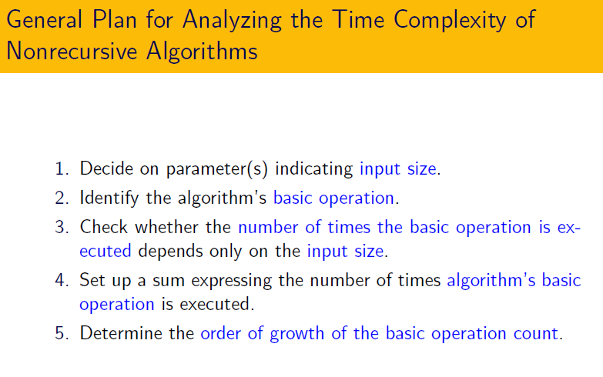
6. Represent Basic operation count using O/ Ω/ Θ/o/ ω

Slide 30
THANK YOU

